Slide 1
Class 설계서
Palzo

Slide 2
변경 이력
일자 | 버전 | 변경 내역 | 작성자
2018-04-30 | V.0.0 | 초안 작성 | 김한동
2018-05-01 | V.0.1 | 클래스 구분 별 작성 | 김한동
2018-05-02 | V.1.0 | RegiList, EditList 수정 | 김한동
2018-05-03 | V.2.0 | 클래스 간 관계 표현, 바운더리 클래스 이름 수정 | 김한동
2018-05-03 | V.2.1 | 회원정보찾기 관련 클래스 속성 및 메소드 수정 | 김한동

Slide 3
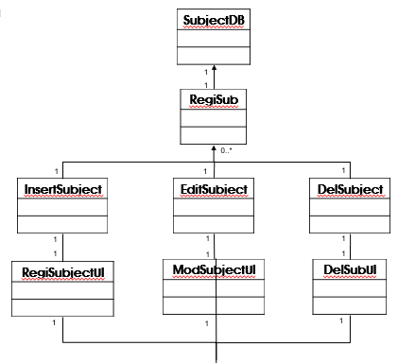
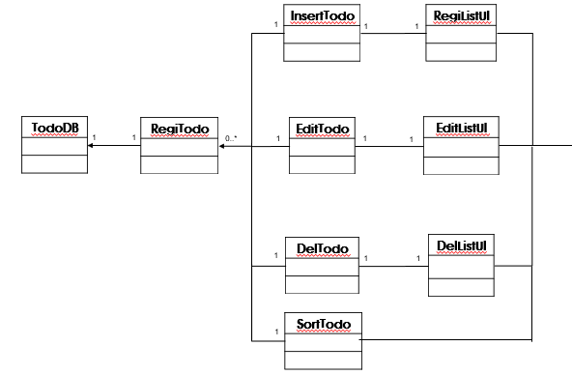
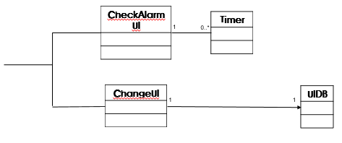
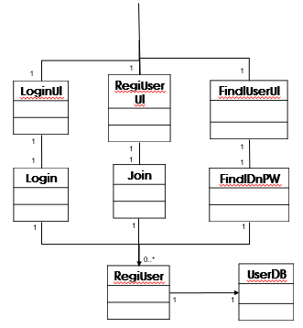
Class Diagram
1
MainUI
1
1
1

Slide 4
Class Diagram
1
1
1
LoginUI
RegiUserUI
FindIUserUI
1
1
1
1
1
1
Login
Join
FindIDnPW
1
1
1
0..*
RegiUser
UserDB
1
1

Slide 5
Class Diagram
SubjectDB
1
1
RegiSub
0..*
1
1
1
InsertSubject
EditSubject
DelSubject
1
1
1
1
1
1
RegiSubjectUI
ModSubjectUI
DelSubUI
1
1
1

Slide 6
InsertTodo
RegiListUI
1
1
1
TodoDB
RegiTodo
EditTodo
EditListUI
1
1
0..*
1
1
1
DelTodo
DelListUI
1
1
1
SortTodo
1

Slide 7
Class Diagram
CheckAlarmUI
Timer
1
0..*
ChangeUI
UIDB
1
1

Slide 8
Entity Class
UserDB
-userID : String -userPW : String -userEmail : String
+MemberInfo() : Boolean
SubjectDB
-subName : String -subPro : String -subRoom : Int -subYear : Int -subSem : Int -subDate : String -subTime : Int
+SubjectInfo() : Boolean
TodoDB
-listName : String -listSub : String -endYear : Int -endMonth : Int -endDay : Int -RendYear : Int -RendMonth : Int -RendDay : Int -Importance : Int -Completance : Int
+ListInfo() : Boolean
UIDB
-red : Int -blue : Int -green : Int -black : int -white : Int
+UIInfo() : Int

Slide 9
Control Class
Login
-inputID : String -inputPW : String -acess : Boolean
+LoginF() : Boolean
Join
-userID : String -userPW : String -userEmail : String -checkID : Boolean -checkEmail : Boolean -UDB : UserDB
+JoinF() : Boolean
FindIDnPW
-inputEmail : String -search : Boolean
+returnIDnPW(inputEmail) : String +FindIDnPWF() : Boolean
RegiUser
-con : Connection -pst : PreparedStatement -rs : ResultSet -sql : String -in : Scanner
+UserTable(String ID, String PW, String Email) : void
RegiSub
-con : Connection -pst : PreparedStatement -rs : ResultSet -sql : String -in : Scanner
+SubTable(String subName, String subPro, Int subRoom, Int subYear, Int subSem, Int subDate, Int subTime) : void +RegiSubF() : Boolean
InsertSubject
-subName : String -subPro : String -subRoom : Int -subYear : Int -subSem : Int -subDate : String -subTime : Int -subObject : SubjectDB
+InsertSubF() : Boolean +AddSub(SubjectDB subObject) : void

Slide 10
Control Class
EditSubject
-subName : String -subPro : String -subRoom : Int -subYear : Int -subSem : Int -subDate : String -subTime : Int -subObject : SubjectDB
+EditSubF() : Boolean +EditSubject(String subName, String subPro, Int subRoom, Int subYear, Int subSem, Int subDate, Int subTime) : void
DelSubject
-subName : String -subObject : SubjectDB
+DelSubF() : Boolean +DeleteSubject(String subName) : void
RegiTodo
-con : Connection -pst : PreparedStatement -rs : ResultSet -sql : String -in : Scanner
+TodoTable(String listName, String listSub, Int endYear, Int endMonth, Int endDay, Int RendYear, Int RendMonth, Int RendDay, Int Importance, Int Completance) : void +RegiTodoF() : Boolean
InsertTodo
-listName : String -listSub : String -endYear : Int -endMonth : Int -endDay : Int -RendYear : Int -RendMonth : Int -RendDay : Int -Importance : Int -Completance : Int -todoObject : TodoDB
+InsertTodoF() : Boolean +AddTodo(TodoDB todoObject) : void

Slide 11
Control Class
EditTodo
-listName : String -listSub : String -endYear : Int -endMonth : Int -endDay : Int -RendYear : Int -RendMonth : Int -RendDay : Int -Importance : Int -Completance : Int -todoObject : TodoDB
+EditTodoF() : Boolean +EditTodolist(String listName, String listSub, Int endYear, Int endMonth, Int endDay, Int RendYear, Int RendMonth, Int RendDay, Int Importance, Int Completance) : void
DelTodo
-listName : String -todoObject : TodoDB
+DelTodoF() : Boolean +DeleteTodolist(String listNmae) : void
SortTodo
-con : Connection -pst : PreparedStatement -rs : ResultSet -sql : String -sel : Int
+ListSubAsc(TodoDB) : DB +CompletanceAsc(TodoDB) : DB +EndyearAsc(TodoDB) : DB +EndmonthAsc(TodoDB) : DB +EnddayAsc(TodoDB) : DB +RendyearAsc(TodoDB) : DB +RendmonthAsc(TodoDB) : DB +RenddayAsc(TodoDB) : DB +ImportanceAsc(TodoDB) : DB +ListNameAsc(TodoDB) : DB
ChangeUI
-sel : Int
+ChangeUIF() : Boolean +DoChangeUI : void
Timer
-CurrentTime : Int -comp : boolean
+AlarmF() : Boolean

Slide 12
Boundary Class
LoginUI
-logniButton : JButton -regiButton : JButton -findInfo : JButton -idLabel : JLabel -idText : JTextField -idField : String -pwLabel : JLabel -pwText : JTextField -pwField : String
+JoinF() +FindIDnPWF() +MemberInfo() +MainUIF()
RegiUserUI
-checkId : JButton -checkPw : Jbutton -doCancel : Jbutton -doRegit : JButton -idLabel : JLabel -idText : JTextField -idField : String -pwLabel : JLabel -pwText : JTextField -pwField : String -emLabel : Jlabel -emText : JTextField -emField : String
+LoginF() +UserTable(String ID, String PW, String Email)
FindIUserUI
-sendButton : JButton -doCancel : Jbutton -emLabel : Jlabel -emText : JTextField -emField : String
+LoginF() +FindIDnPWF()
MainUI
-ShowF() : Boolean -allListButton : Jbutton -subListButton : Jbutton -sublistName : Jlabel -addSubButton : Jbutton -editSubButton : JButton -delSubButton : Jbutton -todolistName : JLabel -arrList : JScrollPane -edittodoList : Jbutton -deltodoList : Jbutton -logoutButton : Jbutton -changeUiScroll : JScrollPane
+InsertSubF() +EditSubF() +DelSubF() +InsertTodoF() +EditTodoF() +DelTodoF() +ChangeUiF() +LoginF()

Slide 13
Boundary Class
RegiSubjectUI
-nameLabel : Jlabel -proLabel : Jlabel -roomLabel : Jlabel -semLabel : Jlabel -timeLabel : Jlabel -nameTextField : JTextField -nameText : String -proTextField : JTextField -proTextField : String -roomTextField : JTextField -yearScroll : JScrollPane -semeScroll : JScrollPane -dateScroll : JScrollPane -hourScroll : JScrollPane -minScroll : JScrollPane -addTimeButton : Jbutton -doCancel : Jbutton -regiSubButtion : JButton
+SubTable(String subName, String subPro, Int subRoom, Int subYear, Int subSem, Int subDate, Int subTime) +RegiSubF() +MainUIF()
ModSubjectUI
-nameLabel : Jlabel -proLabel : Jlabel -roomLabel : Jlabel -semLabel : Jlabel -timeLabel : Jlabel -nameTextField : JTextField -nameText : String -proTextField : JTextField -proTextField : String -roomTextField : JTextField -yearScroll : JScrollPane -semeScroll : JScrollPane -dateScroll : JScrollPane -hourScroll : JScrollPane -minScroll : JScrollPane -addTimeButton : Jbutton -doCancel : Jbutton -regiSubButtion : JButton
+EditSubF() +EditSubject(String subName, String subPro, Int subRoom, Int subYear, Int subSem, Int subDate, Int subTime) +MainUIF()
DelSubUI
-subNameLabel : Jlabel -messageLabel : Jlabel -yesButton : Jbutton -noButton : JButton
+DelSubF() +DeleteSubject(String subName) +MainUIF()

Slide 14
Boundary Class
RegiListUI
-nameLabel : Jlabel -subScroll : JScrollPane -endYearScroll : JScrollPane -endMonthScroll : JScrollPane -endDayScroll : JScrollPane -RendYearScroll : JScrollPane -RendMonthScroll : JScrollPane -RendDayScroll : JScrollPane -Importance : JScrollPane -Completance : JScrollPane -doCancel : Jbutton -doRegit : Jbutton
+TodoTable(String listName, String listSub, Int endYear, Int endMonth, Int endDay, Int RendYear, Int RendMonth, Int RendDay, Int Importance, Int Completance) +RegiTodoF() +MainUIF()
EditListUI
-nameLabel : Jlabel -subScroll : JScrollPane -endYearScroll : JScrollPane -endMonthScroll : JScrollPane -endDayScroll : JScrollPane -RendYearScroll : JScrollPane -RendMonthScroll : JScrollPane -RendDayScroll : JScrollPane -Importance : JScrollPane -Completance : JScrollPane -doCancel : Jbutton -doRegit : JButton
+EditTodoF() +EditTodolist(String listName, String listSub, Int endYear, Int endMonth, Int endDay, Int RendYear, Int RendMonth, Int RendDay, Int Importance, Int Completance) +MainUIF()
DelListUI
-listNameLabel : Jlabel -messageLabel : Jlabel -yesButton : Jbutton -noButton : Jbutton
+DelTodoF() +DeleteTodolist(String listNmae) +MainUIF()
CheckAlarmUI
-listNameLabel : Jlabel -messageLabel : Jlabel -turnoffButton : JButton
+AlarmF() +MainUIF()

